Slide 1

Nội dung
PHP MySQL Database
PHP Connect to MySQL
PHP CRUD Into MySQL
SQL Injection
PHP Prepared Statements
MVC

Slide 2
PHP MySQL Database
MySQL is the most popular database system used with PHP.
The data in a MySQL database are stored in tables. A table is a collection of related data, and it consists of columns and rows.
Management in Xampp: phpAdmin

Slide 3
PHP Connect to MySQL
PHP 5 and later can work with a MySQL database using
MySQLi extension (the "i" stands for improved)
PDO (PHP Data Objects)

Slide 4
MySQLi or PDO?
PDO will work on 12 different database systems, where as MySQLi will only work with MySQL databases
Both support Prepared Statements. Prepared Statements protect from SQL injection, and are very important for web application security.

Slide 5
MySQL Change Pass for user root
Xampp Shell
mysql -h localhost -u root
SET PASSWORD FOR root@localhost = PASSWORD('yourpassword');
config.inc.php: $cfg['Servers'][$i]['password'] = 'mật khẩu mới';

Slide 6
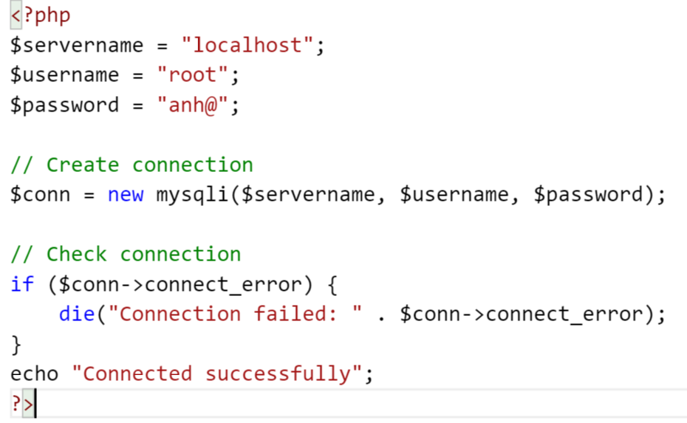
MySQLi Object-Oriented

Slide 7
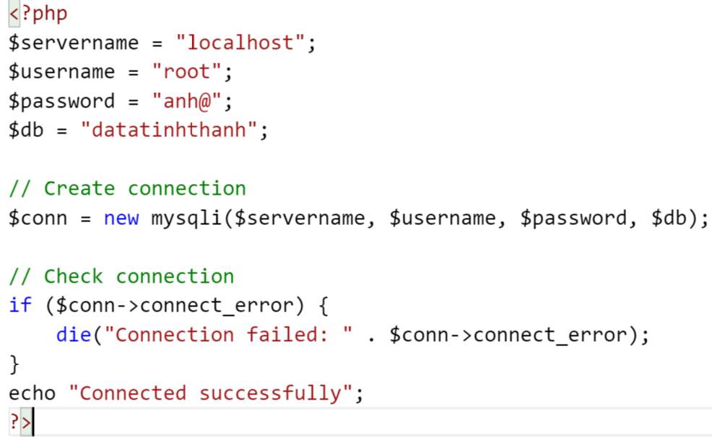
MySQLi Object-Oriented

Slide 8
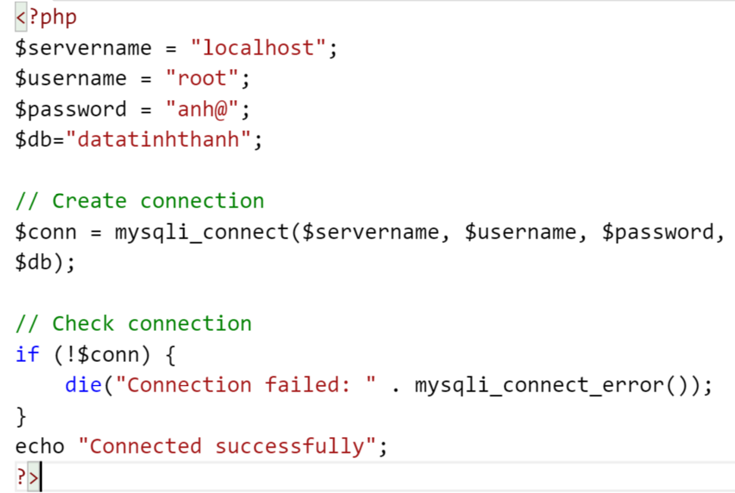
MySQLi Procedural)

Slide 9
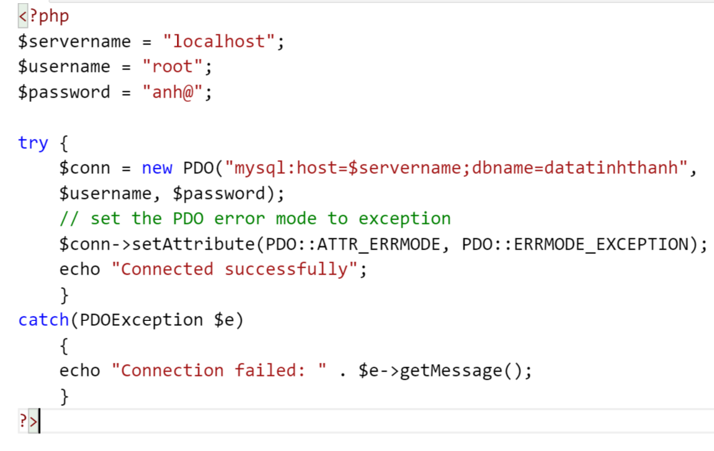
PDO

Slide 10
Close the Connection
MySQLi Object-Oriented: $conn->close();
MySQLi Procedural: mysqli_close($conn);
PDO: $conn = null;

Slide 11
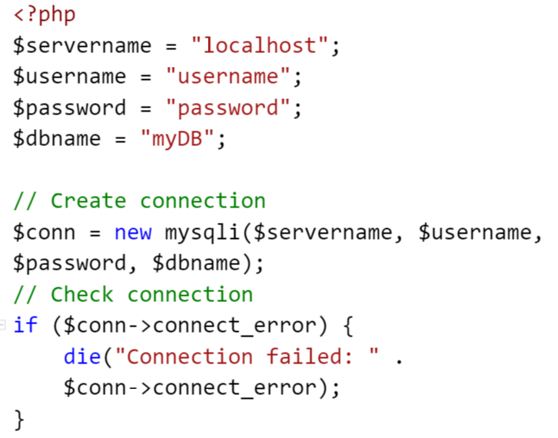
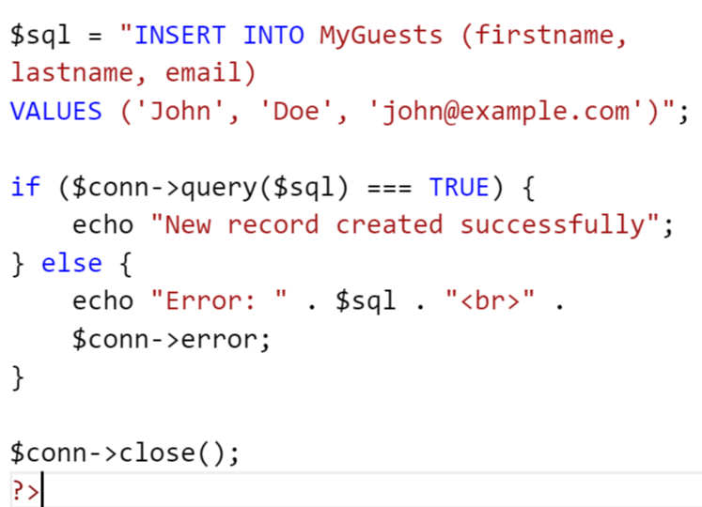
PHP Insert Data Into MySQL

Slide 12
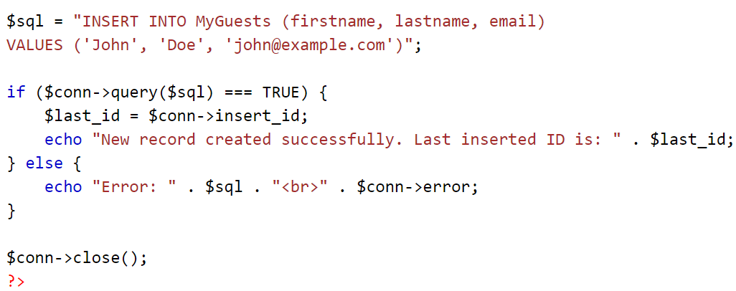
Get ID of The Last Inserted Record
INSERT or UPDATE on a table with an AUTO_INCREMENT field, we can get the ID of the last inserted/updated record immediately.

Slide 13
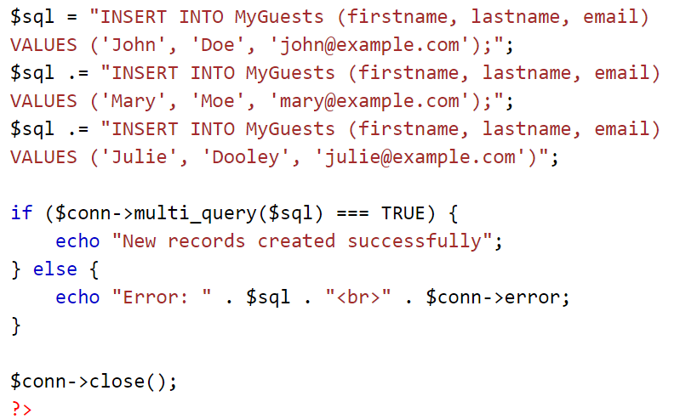
PHP Insert Multiple Records Into MySQL

Slide 14
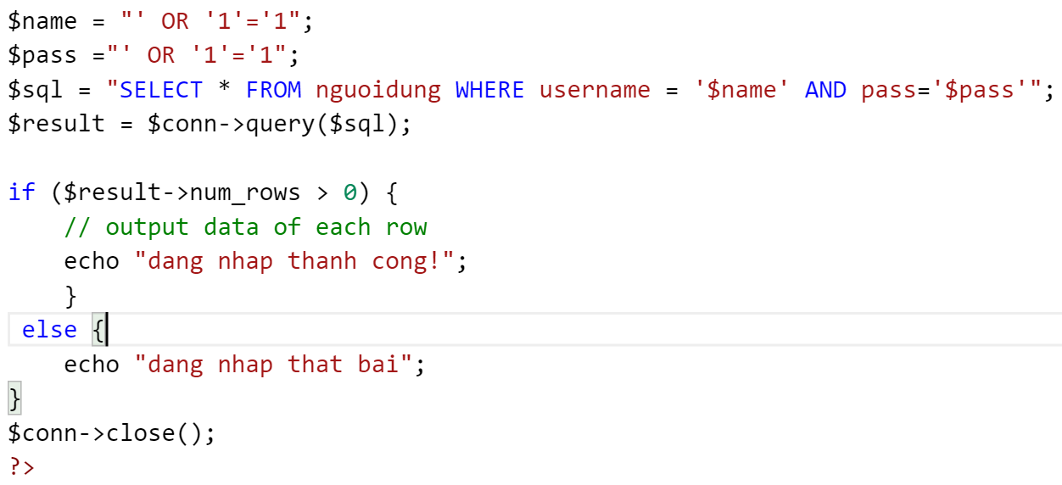
SQL injection

Slide 15
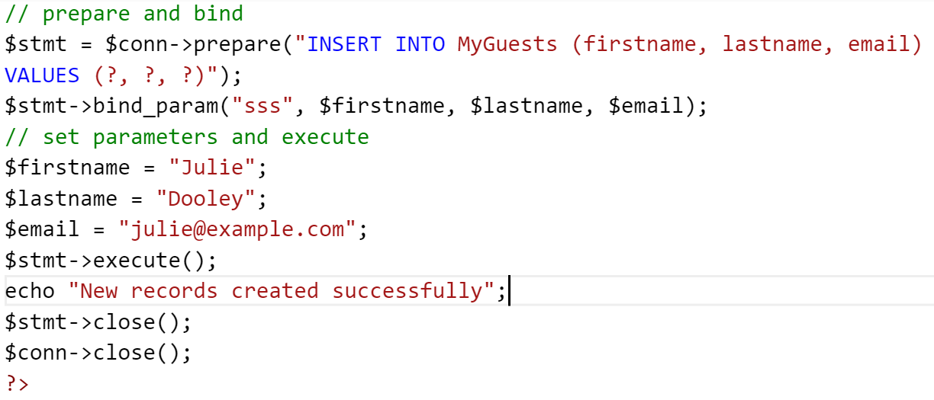
PHP Prepared Statements
Prepared statements are very useful against SQL injections.

Slide 16
PHP Prepared Statements
The argument may be one of four types
i - integer
d - double
s - string

Slide 17
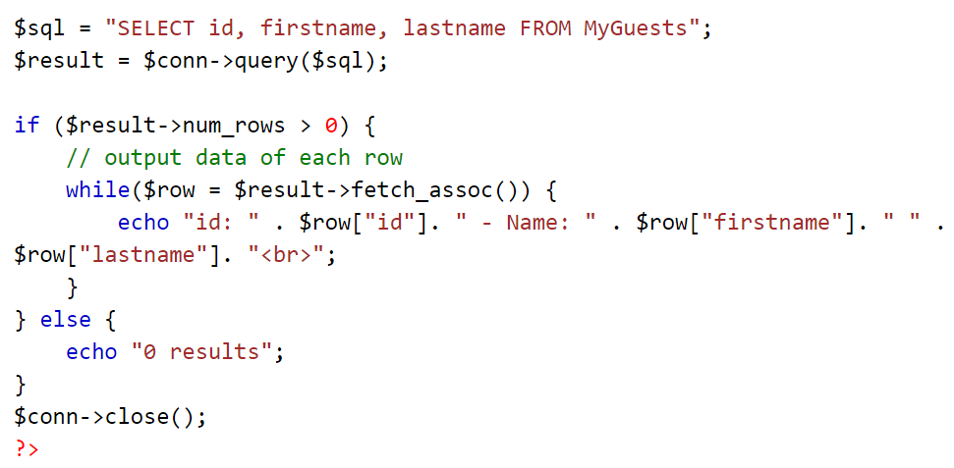
PHP Select Data From MySQL

Slide 18
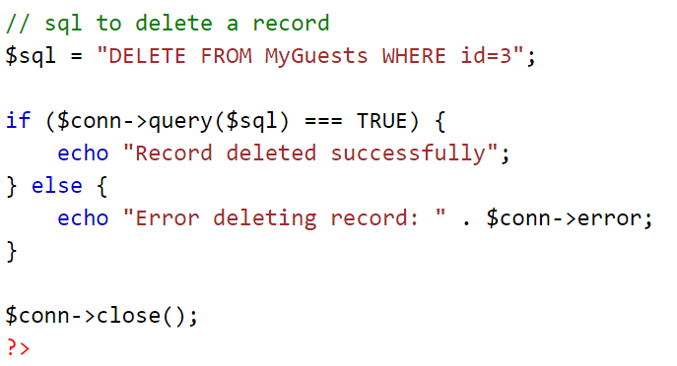
PHP Delete Data From MySQL

Slide 19
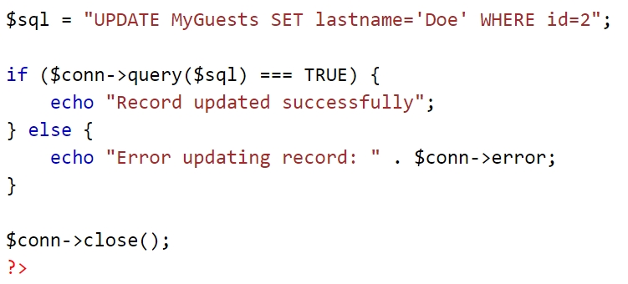
PHP Update Data in MySQL

Slide 20
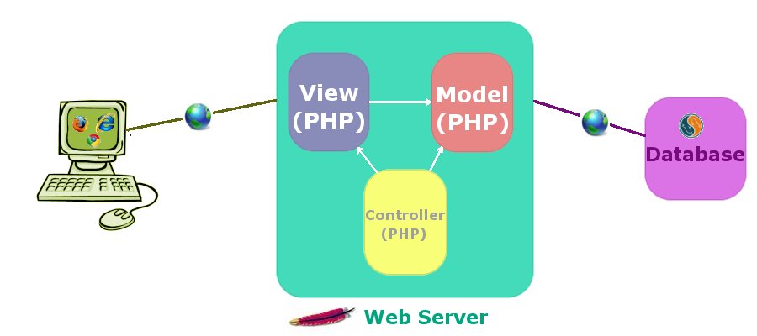
MVC PHP

Slide 21
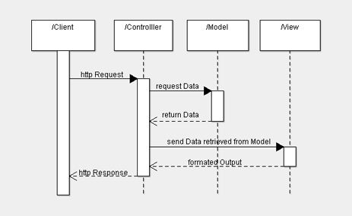
MVC PHP

